Slide 1

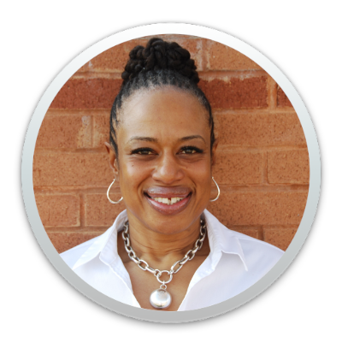
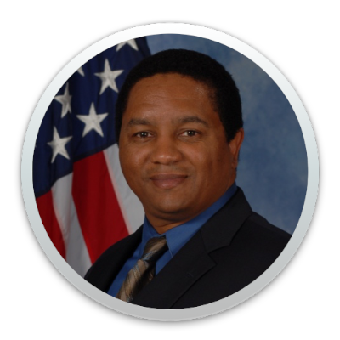
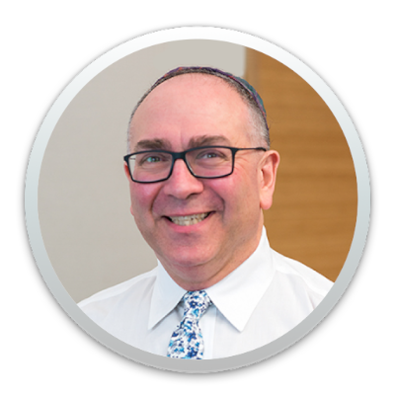
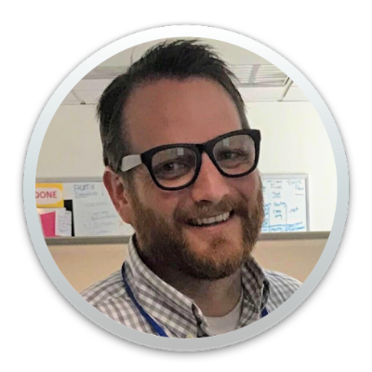
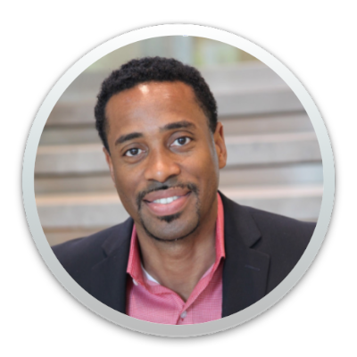
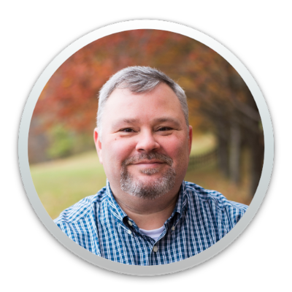
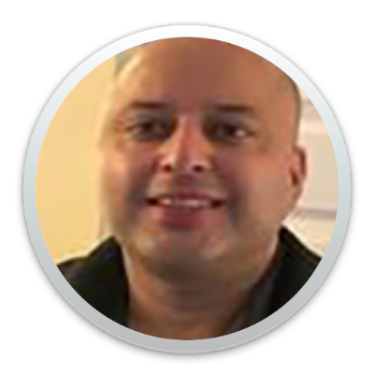
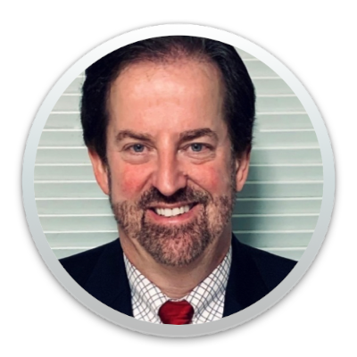
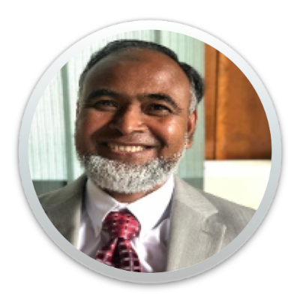
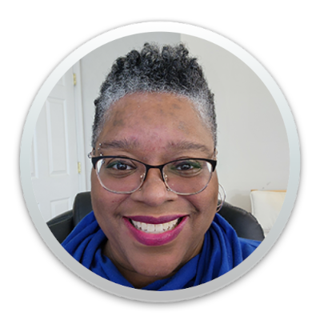
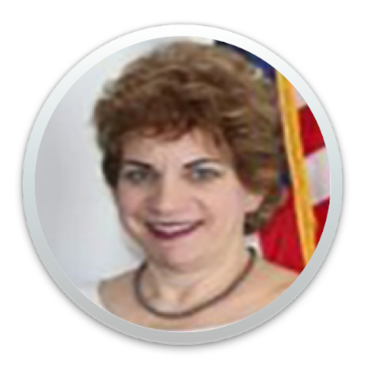
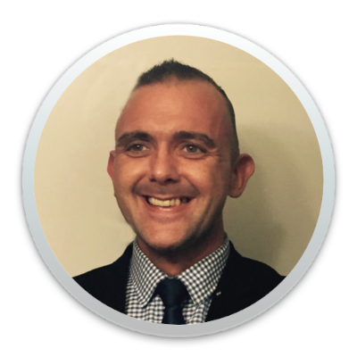
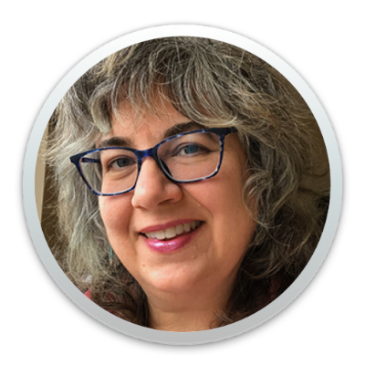
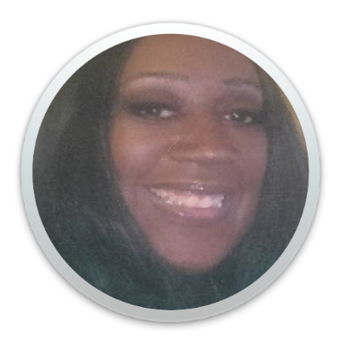
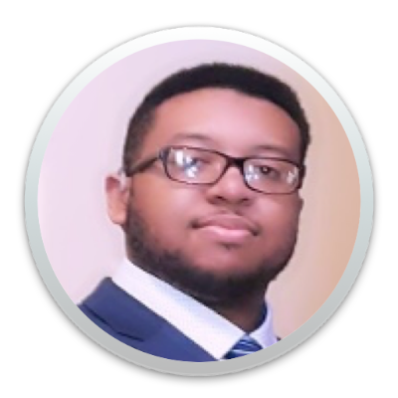
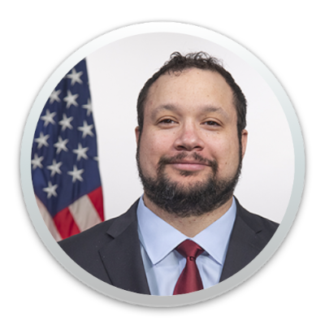
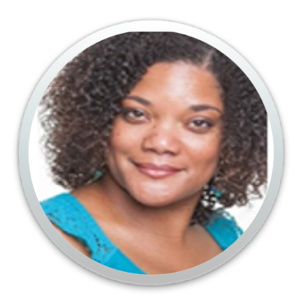

Unlocking the Power of Accessibility IAAF Chair and Committee Members
Words from the Chair
I want to send a special Thank You for this great group of people who have served on the IAAF Committee.
You’ve worked tirelessly for a number of years, supporting the IAAF Forum by giving 9 months of your time yearly to bring all of this together. Thank you for making time in your already busy schedules, to come together as team, to make sure this event happens. I personally want each of you to know your hard work, your willingness to help and share your ideas does not go unnoticed. I appreciate your skills, and how you collaborate together. Each of you represent the finest in the Federal government workforce. To me you are the individuals that will get the job done, so there is no reason to look any further. You embody what it means to work as Team. So, here's to you, team! You are the Power of Accessibility.
Thank you for a memorable five years and I know you will continue to do great things.
~Yvette Gibson, GSA, Chair
Yvette Gibson, GSA
Chair
Steven Harding, GSA
Host
Gary Morin, NIH
Host
Andrew Nielson, CIOC ACOP, Host
Arthur Brunson, GSA
Committee Member
Michael Horton, GSA
Committee Member
Sid Sharma, DOI
Committee Member
Tim Creagan, USAB
Committee Member
Mohamed Islam, GSA
Committee Member
Angela Watkins, PBGC
Committee Member
Angie Fuoco, EPA
Committee Member
Dennis Oden, MSPB
Committee Member
Martha Wilkes, VA
Committee Member
Kenya Goodman, DOL
Committee Member
Darius Rahmaan, GSA
Committee Member
Alex Wilson, GSA
Committee Member
Lolita Horne, DAU
Committee Member
Avis Ryan, GSA
Committee Member

